Slide 1


Global Warming and Climate change
Sub: Environmental Studies (CHM 1002)
Lecture series
By
Dr. Abanti Pradhan
Associate Professor
Dept. of Chemistry, ITER, Bhubaneswar
SOA [ deemed to be University]

Slide 2

Contents
Introduction of Global Warming and Climate Change
Causes of Climate Change
Working Principle of Green House Gases
Types, Sources, Level and Production of Green House Gases
Depletion of Stratospheric Ozone and Climate Change
Impact of Global Warming
Global Climate Change Model and Earth energy Budgets
Mitigation of Global Warming
Notes:
2

Slide 3
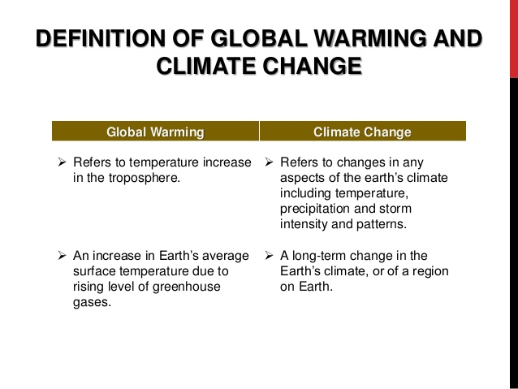

Slide 4
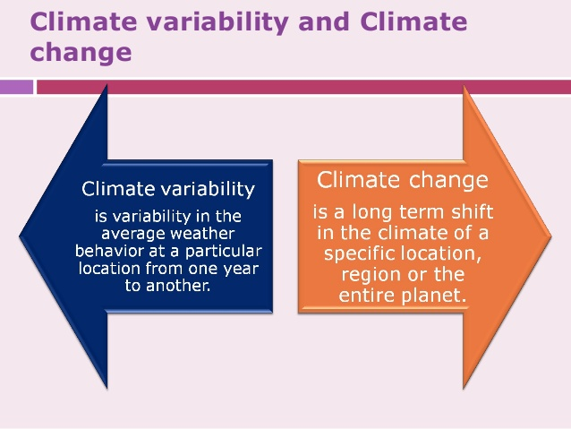
Causes of Climate Change
Feedback Mechanisms
Anthropogenic Global Warming
Bio-thermostat
Variations in Solar Radiation
Solar Irradiance
Sunspot Activity
Earth-Sun Geometry (Milankovitch cycles)
Atmospheric Dust and Volcanoes
Distribution of Continents Plate Tectonics Mountain Building
Ocean Variation
Thermohaline Circulation

Slide 5
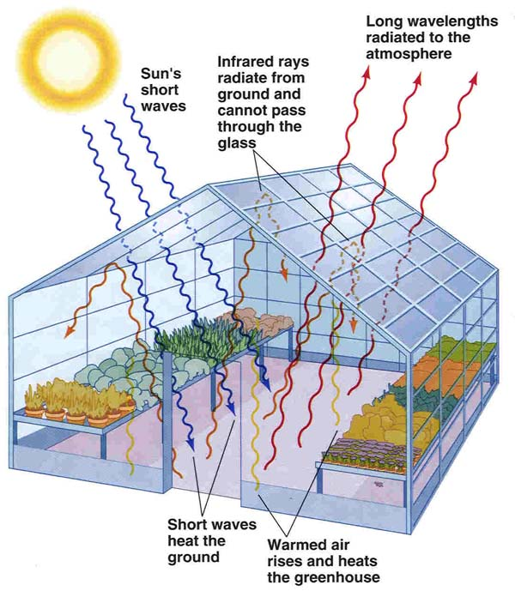
Anthropogenic Global Warming
Principle of Green House Gases ?

Slide 6
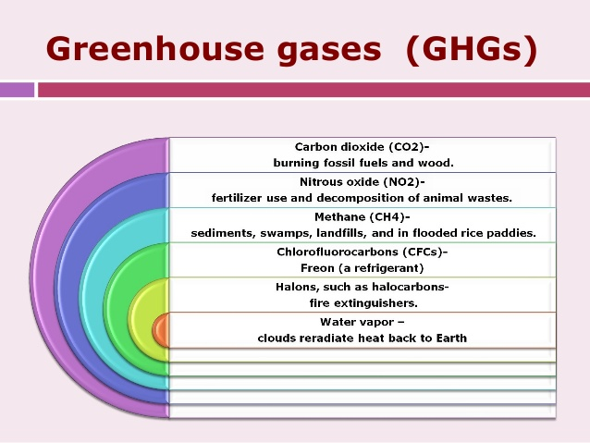
Type and sources Greenhouse Gases
H₂O = 1-3%
CO₂ = .035%
CH₄
N₂O
O₃
CFC’s
High
Conc.
Sources of ozone
Naturally occurring
Anthropogenic
Trace
Hydrofluorocarbons (HFCs), perfluorocarbons (PFCs) and sulphur hexafluoride (SF₆).
Sources of Green house gases

Slide 7
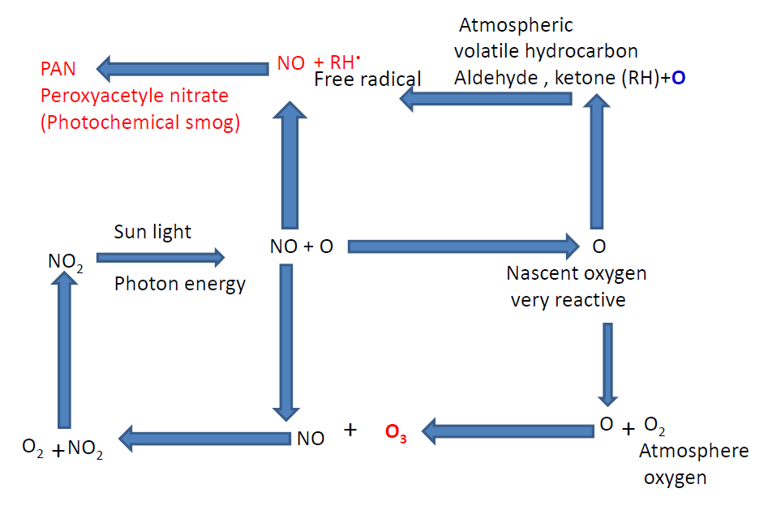
Photochemical Smog and formation of ground level Ozone

Slide 8
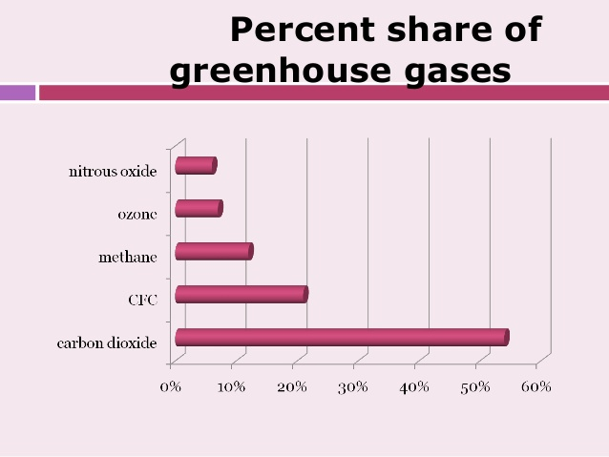

Slide 9
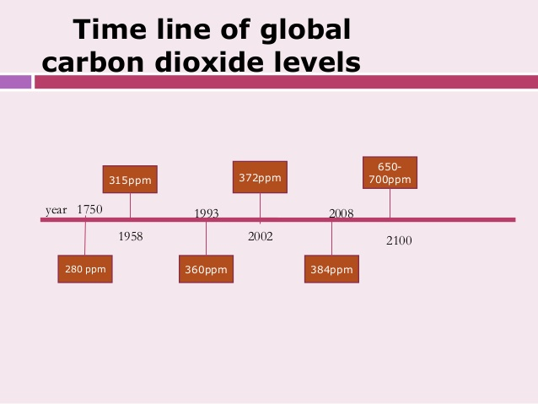

Slide 10
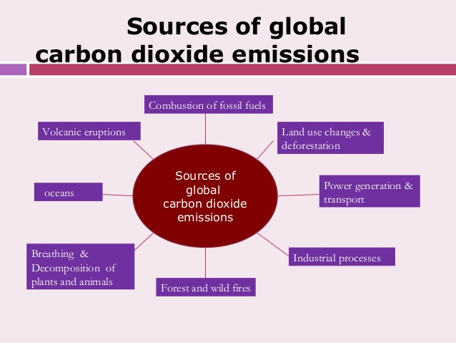

Slide 11
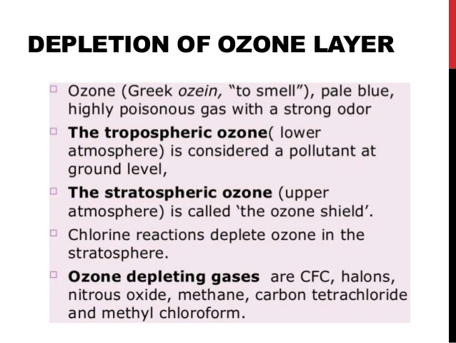
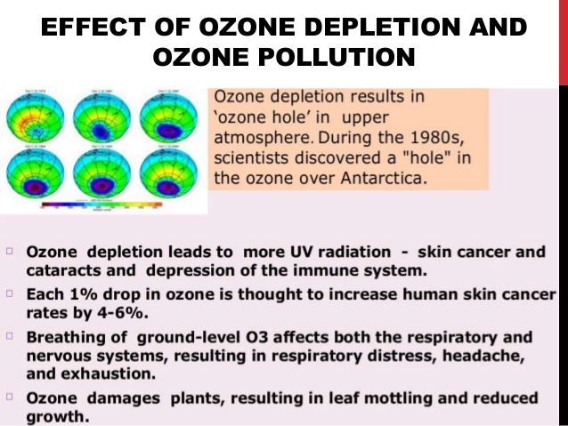
Depletion of Stratospheric Ozone and Climate change

Slide 12
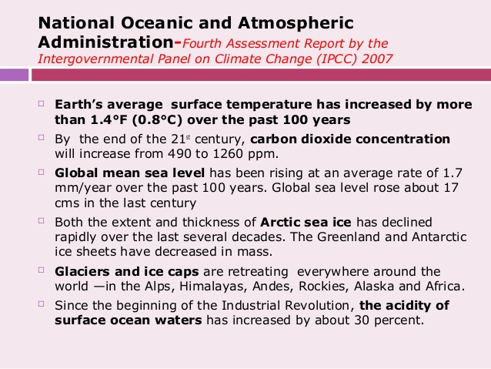
Influence amount and pattern of precipitation, Drought

Slide 13
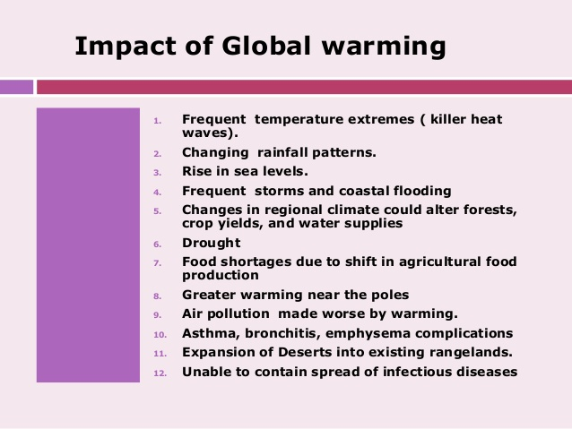

Slide 14
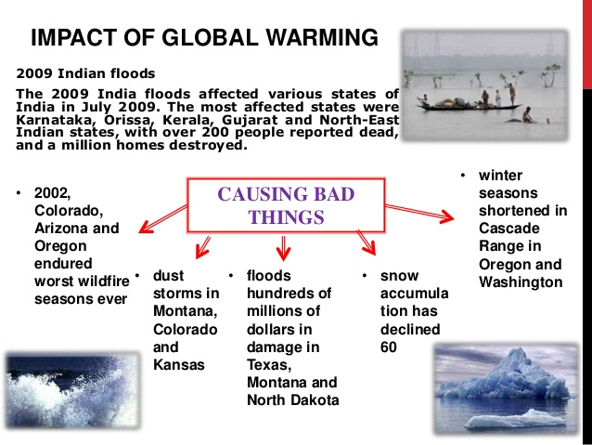
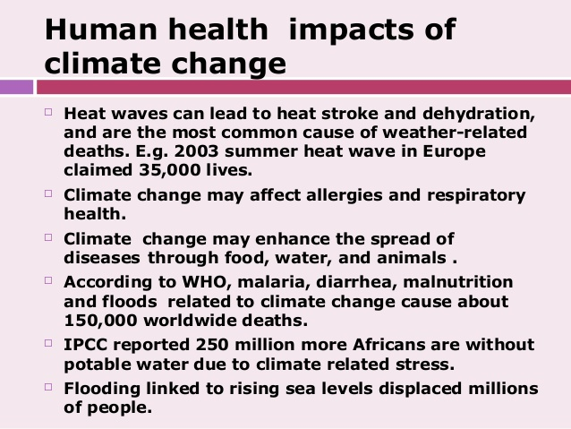

Slide 15
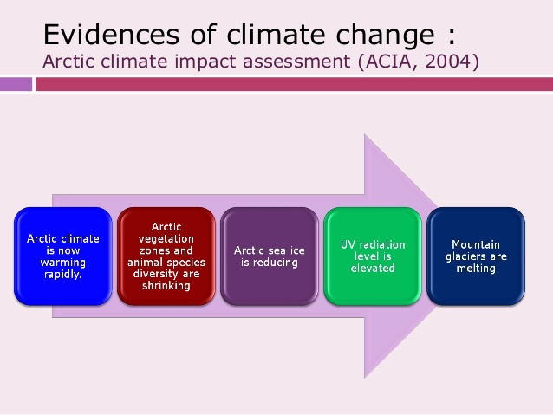

Slide 16
Earth energy Budgets

Slide 17
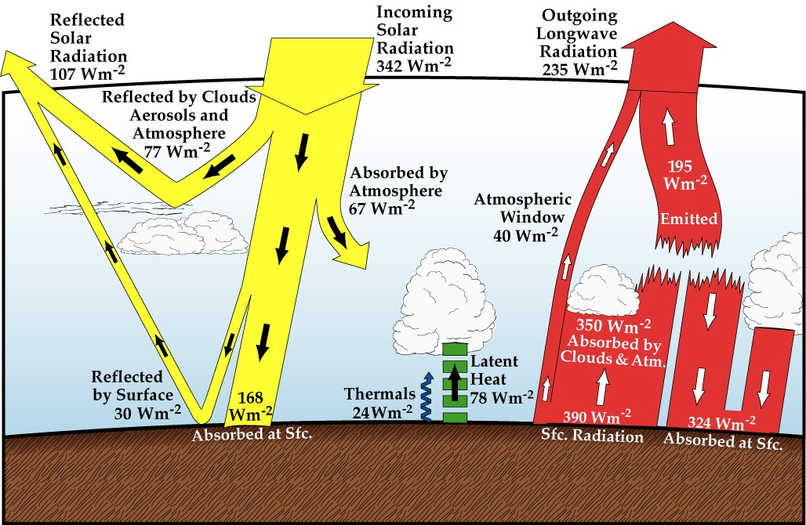

Pathways of energy transfer in a global average
26 W/M2 lost to atmosphere
by convection of water
7-13 µm
Condensation of water vapor
Recap: Figure 2.8
Neelin, 2011. Climate Change and Climate Modeling, Cambridge UP
Notes:
global.energy.bal.clr.eps from chap2

Slide 18
Global climate change Model

Slide 19
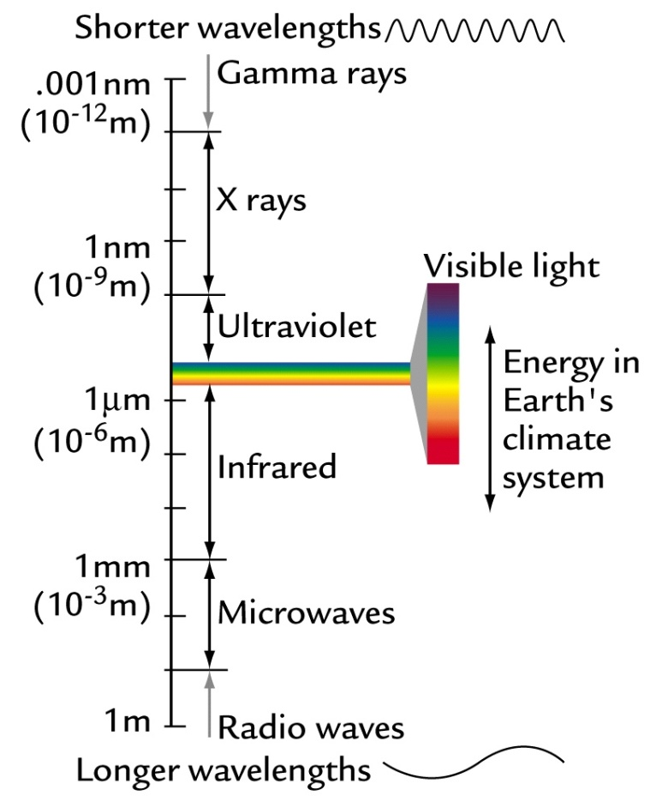
Black Body Radiation
A blackbody is something that emits (or absorbs) electromagnetic radiation with 100% efficiency at all wavelengths.
Blackbody radiation is the radiation emitted at a characteristic wavelength that depends on the body’s absolute temperature.
Wien’s Law - Peak wavelength emitted by a body
λ_{peak} (in microns) = 2877/TK
For Sun:
5780K = temp of photosphere
λ_{peak sun} = 2877/5780
= 497 nm
= 4.97 x 10⁻⁷ m
λ_{max} ≈ ²⁸⁹⁸/_{T}

Slide 20
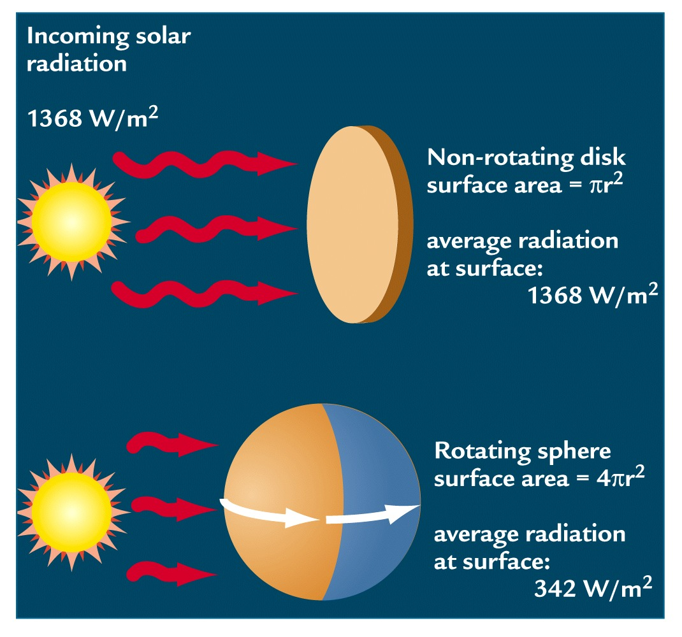
Solar Constant
Stephan-Boltzman Law (Energy emitted)
E = σT⁴
= Stephan-Boltzman constant = 5.67 x 10⁻⁸ Wm⁻²K⁻⁴
E is proportional to the area under the Planck function curve
E_{sun} = 6.3 x 10⁷ W/m²
Only a small fraction of sun’s energy is received by the Earth

Slide 21
Earth
Incoming radiation is short wave.
Outgoing radiation is long wave.
If the Earth is a blackbody at steady state
Incoming = outgoing
Energy_{in} = Energy_{out}

Slide 22
Earth- Incoming Radiation
Solar radiation intersects Earth as a disk (πr²)
Energy_{in} = Energy_{in} from sun (S) – Reflected Solar Energy
= πr² S - πr² Sα
Where:
r = radius of Earth (6360 km)
S = solar constant (1368 W/m²)
= albedo (earth’s reflectivity) (~30%)
= πr² S (1- α)

Slide 23
Earth- Outgoing Radiation
Earth radiates as a sphere with area 4πr² (m²)
Stephan-Boltzmann equations defines outgoing energy based on radiating temperature
Energy_{out} = 4πr² σT_{e}⁴
(units (m²)(Wm⁻²K⁻⁴)(K⁴) = W
Total energy emitted by the Earth

Slide 24
Earth’s Radiation Budget
If the earth were a black body the in = out
Set incoming = outgoing
πr² S (1- α) = 4πr² σT_{e}⁴
Simplify:
S/4 (1- α) = σT_{e}⁴
Solve for T_{e}
T_{e} = 255K (-18 °C)

Slide 25
Earth as a Black Body
Earth’s actual surface temperature
T_{s} = 288K (15°C)
λ_{peak} (μm) = 2877/288 = 10 μm (IR)
T_{s} - T_{e} = 288 – 255 = 33
= Earth’s natural greenhouse
Interactions within atmosphere alter radiation budget (Earth is not a black body)
Greenhouse Effect

Slide 26
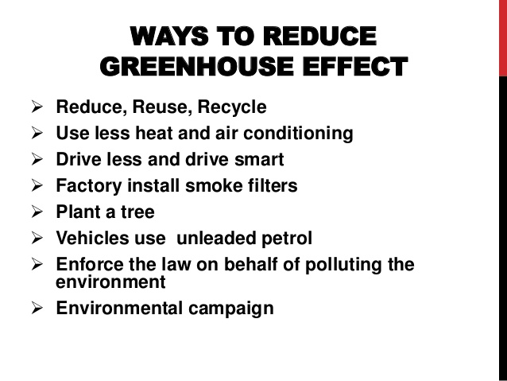
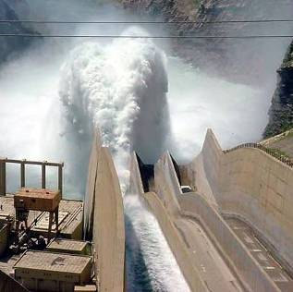
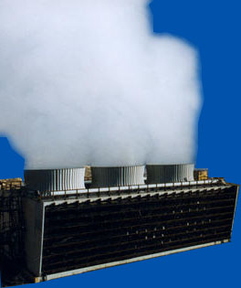
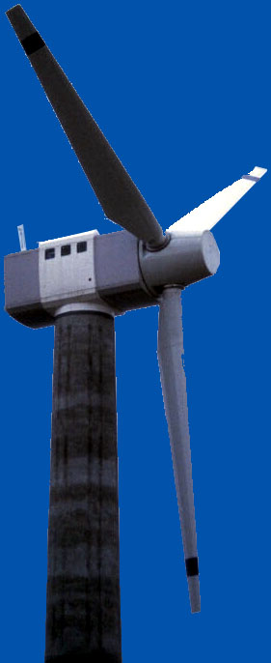
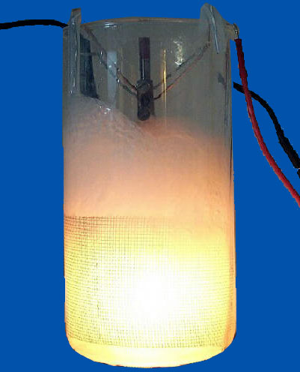
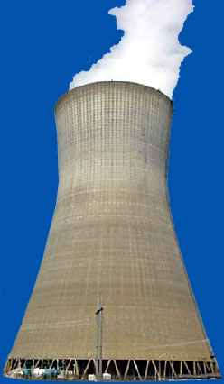
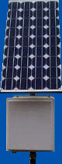

Mitigation of Global Warming
Conservation
Reduce energy needs
Recycling
Alternate energy sources
Nuclear
Wind
Geothermal
Hydroelectric
Solar
Fusion?
Notes:
Methods of mitigating global warming include 
Conservation 
Reduce energy needs, such as electrical usage, petroleum usage, reduced packaging 
Recycling, which uses less energy to produce products compared to 
Another way to reduce carbon emissions is to use alternate energy sources, such as 
Nuclear 
Wind 
Geothermal 
Hydroelectric 
Solar 
Fusion? 

Slide 27
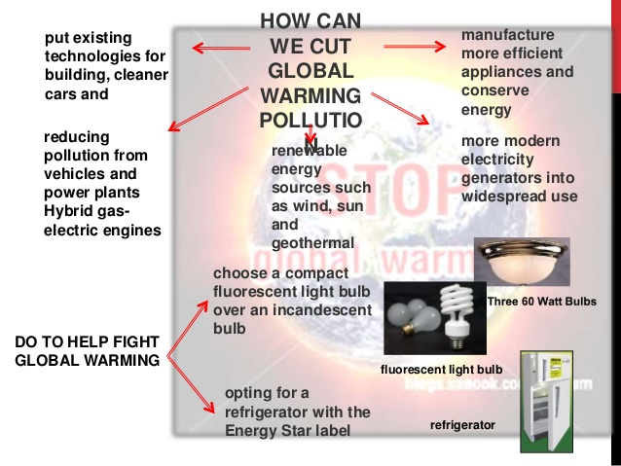

Slide 28
